Slide 1
CUSTOMER MANAGEMENT SYSTEM
NIRIKSHA JHA
Employee id: 200751
August 16, 2023

Slide 2

Introduction
The Customer Management System is a key tool built using Java that helps businesses easily handle their customer information. It lets users add, view, edit, and remove customer details, all through a simple and user-friendly console interface.

Slide 3

Functionalities
01. User Sign Up/ Sign In
02. Admin can view/delete users
New users can sign up and existing users will be able to sign in using their credentials.
Admin has the authority to view all the users and delete them,
03. Customer creation
04. Customer retrieval
05. Customer Update
06. Customer
Deletion
Users will be able to delete customer records. customer records.
Users will be able to add new customer details to the system.
Users will be able to view and search for customer information based on different criteria.
Users will be able to update customer information.

Slide 4
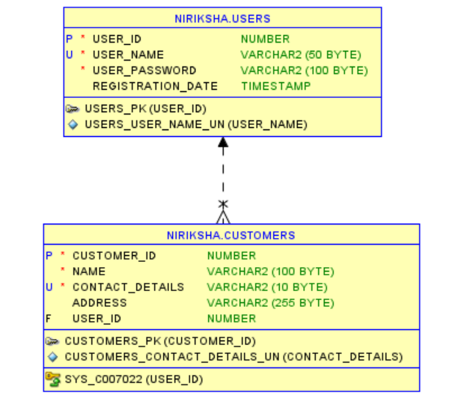
E-R diagram

Slide 5
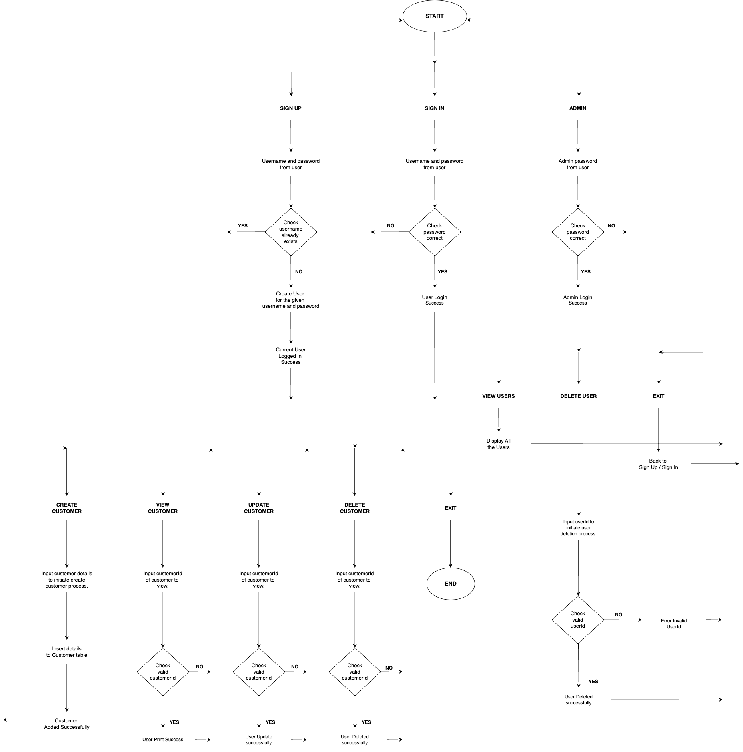
Flow diagram

Slide 6
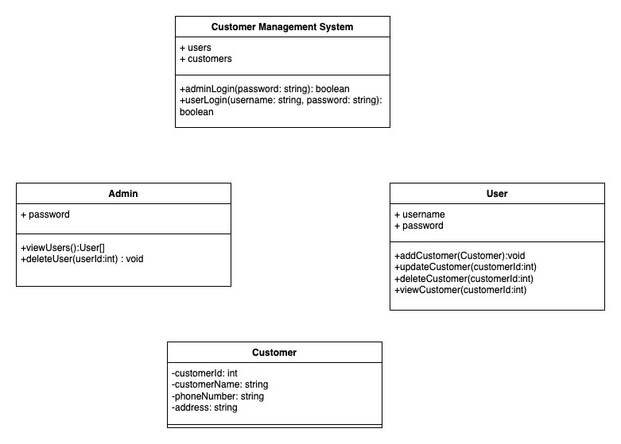
Class diagram

Slide 7
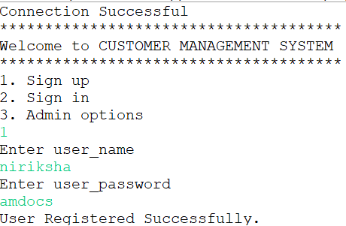
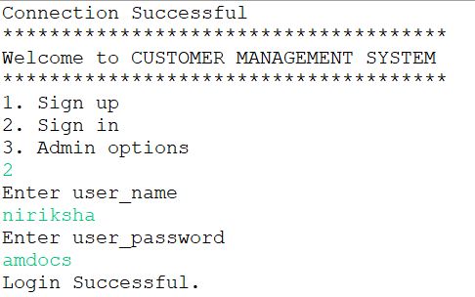
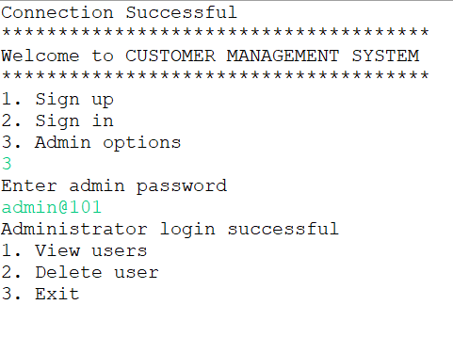
User Login, Signup and Admin options

Slide 8
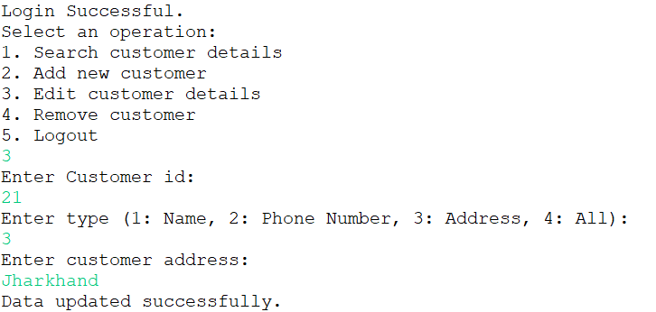
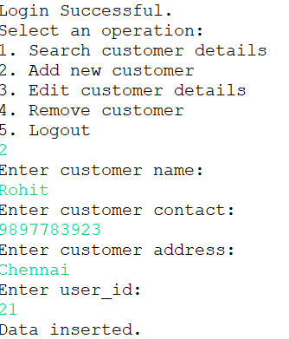
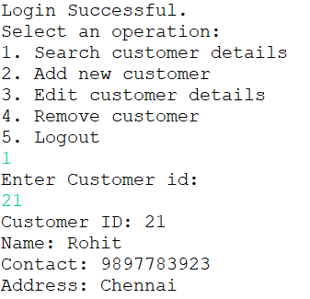
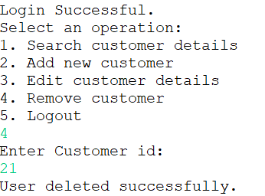
User operations
Updating customer:
Adding customer:
Searching customer:
Deleting customer:

Slide 9

Thank you.

